Slide 1

LendingClub
A case study
Apr, 2023
Abhinav Sinha
Sachin Sachdeva

Slide 2
PROBLEM STATMENT
Lending Club is the largest online loan marketplace, providing loans for medical procedures, personal, and business purposes.
Borrowers can easily access loans at lower interest rates through a fast online process.
Identifying risky loan applicants and understanding the factors that drive default is crucial for the company to reduce losses and manage risk effectively. This is the focus of the present case study.
Lets look at the data ..
Notes:
What’s really clear is the rising importance of Digital as well as disruptive skills. Data science, Machine learning and AI .
Specialized Industry Skills: Skills that are domain or industry-specific that do not fall into any of the other categories. Maybe less transferable across jobs compared to other categories.
Digital Disruptive Skills: Skills associated with technologies and trends the World Bank believes will most impact labor markets in the coming years.
Business Skills: Knowledge and skills required to start or operate an enterprise.
One specific designation that has undergone significant digital transformation in the construction industry is that of the construction project manager. The role of a construction project manager is to oversee all aspects of a construction project, from planning and design to construction and closeout. With the increasing complexity of construction projects and the need for more collaboration and communication, digital technologies have become essential in this role.

Slide 3

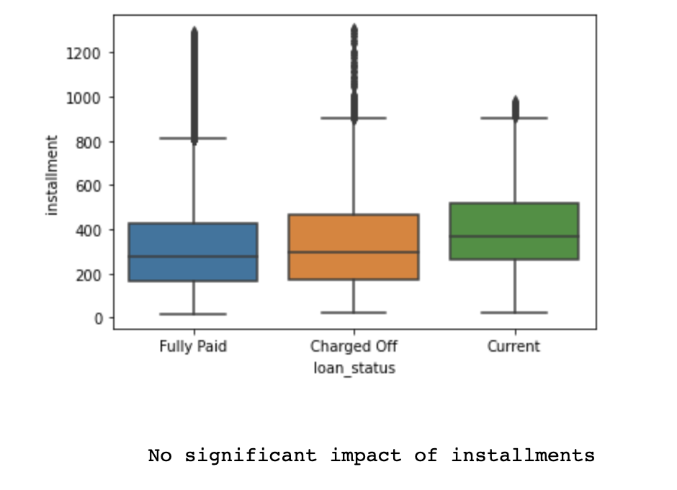

Missing Values
(Seaborn Heatmap)
Relevancy/Impact quick check
(Boxplot)
Data Deep-dive
the file provided ‘loan.csv’ had:
1. 111 Columns
2. 39,717 Rows
The Data was analyzed and cleaned through multiple channels including but not limited to:
Missing value treatment.
Relevancy Check.
Sanity Check.
Value conversion.
Appending support columns.
Missing values visualized on a heatmap to quickly infer the columns that had no values, were subsequently dropped.
Columns with more than 70% missing values were also dropped since imputation could’ve caused an skew.
A quick check on the data reflects the impact of a variable on the dependent variable i.e., loan_status.
Columns that had no impact on the dependent variable were dropped to preserve relevant structure.
Notes:
What’s really clear is the rising importance of Digital as well as disruptive skills. Data science, Machine learning and AI .
Specialized Industry Skills: Skills that are domain or industry-specific that do not fall into any of the other categories. Maybe less transferable across jobs compared to other categories.
Digital Disruptive Skills: Skills associated with technologies and trends the World Bank believes will most impact labor markets in the coming years.
Business Skills: Knowledge and skills required to start or operate an enterprise.
One specific designation that has undergone significant digital transformation in the construction industry is that of the construction project manager. The role of a construction project manager is to oversee all aspects of a construction project, from planning and design to construction and closeout. With the increasing complexity of construction projects and the need for more collaboration and communication, digital technologies have become essential in this role.

Slide 4

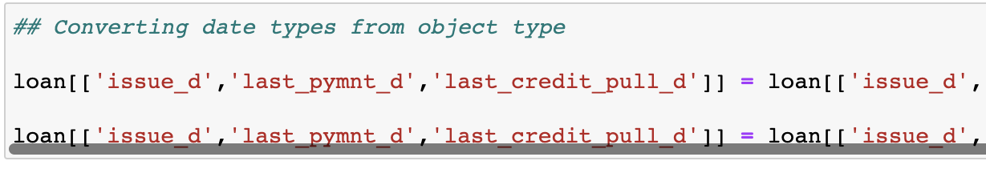
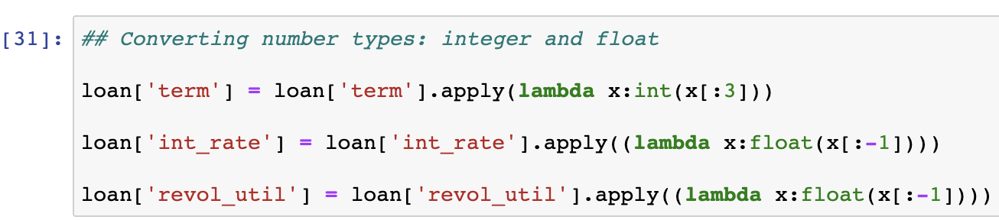
Sanity Check
Value Conversion
Data Deep-dive
the file provided ‘loan.csv’ had:
1. 111 Columns
2. 39,717 Rows
The Data was analyzed and cleaned through multiple channels including but not limited to:
Missing value treatment.
Relevancy Check.
Sanity Check.
Value conversion.
Appending support columns.
Quick check reveals the data types that were read wrongly during the file load.
These data types were separately treated.
The datatypes were corrected to maintain a cohesive data structure.
Notes:
What’s really clear is the rising importance of Digital as well as disruptive skills. Data science, Machine learning and AI .
Specialized Industry Skills: Skills that are domain or industry-specific that do not fall into any of the other categories. Maybe less transferable across jobs compared to other categories.
Digital Disruptive Skills: Skills associated with technologies and trends the World Bank believes will most impact labor markets in the coming years.
Business Skills: Knowledge and skills required to start or operate an enterprise.
One specific designation that has undergone significant digital transformation in the construction industry is that of the construction project manager. The role of a construction project manager is to oversee all aspects of a construction project, from planning and design to construction and closeout. With the increasing complexity of construction projects and the need for more collaboration and communication, digital technologies have become essential in this role.

Slide 5
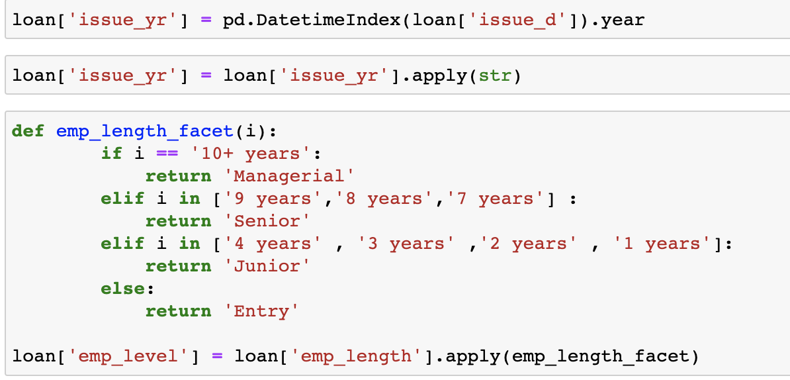
Support columns issue through function
Data Deep-dive
the file provided ‘loan.csv’ had:
1. 111 Columns
2. 39,717 Rows
The Data was analyzed and cleaned through multiple channels including but not limited to:
Missing value treatment.
Relevancy Check.
Sanity Check.
Value conversion.
Appending support columns.
Support columns were issued to simplify the analysis.
This helps us identify patterns and relationships between different variables that might not have been immediately obvious otherwise
Notes:
What’s really clear is the rising importance of Digital as well as disruptive skills. Data science, Machine learning and AI .
Specialized Industry Skills: Skills that are domain or industry-specific that do not fall into any of the other categories. Maybe less transferable across jobs compared to other categories.
Digital Disruptive Skills: Skills associated with technologies and trends the World Bank believes will most impact labor markets in the coming years.
Business Skills: Knowledge and skills required to start or operate an enterprise.
One specific designation that has undergone significant digital transformation in the construction industry is that of the construction project manager. The role of a construction project manager is to oversee all aspects of a construction project, from planning and design to construction and closeout. With the increasing complexity of construction projects and the need for more collaboration and communication, digital technologies have become essential in this role.

Slide 6
ANALYSIS & INSIGHTS
Notes:
What’s really clear is the rising importance of Digital as well as disruptive skills. Data science, Machine learning and AI .
Specialized Industry Skills: Skills that are domain or industry-specific that do not fall into any of the other categories. Maybe less transferable across jobs compared to other categories.
Digital Disruptive Skills: Skills associated with technologies and trends the World Bank believes will most impact labor markets in the coming years.
Business Skills: Knowledge and skills required to start or operate an enterprise.
One specific designation that has undergone significant digital transformation in the construction industry is that of the construction project manager. The role of a construction project manager is to oversee all aspects of a construction project, from planning and design to construction and closeout. With the increasing complexity of construction projects and the need for more collaboration and communication, digital technologies have become essential in this role.

Slide 7
Univariate Bivariate
Notes:
What’s really clear is the rising importance of Digital as well as disruptive skills. Data science, Machine learning and AI .
Specialized Industry Skills: Skills that are domain or industry-specific that do not fall into any of the other categories. Maybe less transferable across jobs compared to other categories.
Digital Disruptive Skills: Skills associated with technologies and trends the World Bank believes will most impact labor markets in the coming years.
Business Skills: Knowledge and skills required to start or operate an enterprise.
One specific designation that has undergone significant digital transformation in the construction industry is that of the construction project manager. The role of a construction project manager is to oversee all aspects of a construction project, from planning and design to construction and closeout. With the increasing complexity of construction projects and the need for more collaboration and communication, digital technologies have become essential in this role.

Slide 8
ANALYSIS
Univariate
(useful for summarizing a large amount of data and for understanding basic attributes of the data)
Notes:
What’s really clear is the rising importance of Digital as well as disruptive skills. Data science, Machine learning and AI .
Specialized Industry Skills: Skills that are domain or industry-specific that do not fall into any of the other categories. Maybe less transferable across jobs compared to other categories.
Digital Disruptive Skills: Skills associated with technologies and trends the World Bank believes will most impact labor markets in the coming years.
Business Skills: Knowledge and skills required to start or operate an enterprise.
One specific designation that has undergone significant digital transformation in the construction industry is that of the construction project manager. The role of a construction project manager is to oversee all aspects of a construction project, from planning and design to construction and closeout. With the increasing complexity of construction projects and the need for more collaboration and communication, digital technologies have become essential in this role.

Slide 9
ANALYSIS
Univariate
(useful for summarizing a large amount of data and for understanding basic attributes of the data)
Notes:
What’s really clear is the rising importance of Digital as well as disruptive skills. Data science, Machine learning and AI .
Specialized Industry Skills: Skills that are domain or industry-specific that do not fall into any of the other categories. Maybe less transferable across jobs compared to other categories.
Digital Disruptive Skills: Skills associated with technologies and trends the World Bank believes will most impact labor markets in the coming years.
Business Skills: Knowledge and skills required to start or operate an enterprise.
One specific designation that has undergone significant digital transformation in the construction industry is that of the construction project manager. The role of a construction project manager is to oversee all aspects of a construction project, from planning and design to construction and closeout. With the increasing complexity of construction projects and the need for more collaboration and communication, digital technologies have become essential in this role.

Slide 10
INSIGHTS
Univariate
(useful for summarizing a large amount of data and for understanding basic attributes of the data)
Notes:
What’s really clear is the rising importance of Digital as well as disruptive skills. Data science, Machine learning and AI .
Specialized Industry Skills: Skills that are domain or industry-specific that do not fall into any of the other categories. Maybe less transferable across jobs compared to other categories.
Digital Disruptive Skills: Skills associated with technologies and trends the World Bank believes will most impact labor markets in the coming years.
Business Skills: Knowledge and skills required to start or operate an enterprise.
One specific designation that has undergone significant digital transformation in the construction industry is that of the construction project manager. The role of a construction project manager is to oversee all aspects of a construction project, from planning and design to construction and closeout. With the increasing complexity of construction projects and the need for more collaboration and communication, digital technologies have become essential in this role.

Slide 11
ANALYSIS
Bivariate
(useful for summarizing a large amount of data and for understanding basic attributes of the data)
Notes:
What’s really clear is the rising importance of Digital as well as disruptive skills. Data science, Machine learning and AI .
Specialized Industry Skills: Skills that are domain or industry-specific that do not fall into any of the other categories. Maybe less transferable across jobs compared to other categories.
Digital Disruptive Skills: Skills associated with technologies and trends the World Bank believes will most impact labor markets in the coming years.
Business Skills: Knowledge and skills required to start or operate an enterprise.
One specific designation that has undergone significant digital transformation in the construction industry is that of the construction project manager. The role of a construction project manager is to oversee all aspects of a construction project, from planning and design to construction and closeout. With the increasing complexity of construction projects and the need for more collaboration and communication, digital technologies have become essential in this role.

Slide 12
ANALYSIS
Bivariate
(useful for summarizing a large amount of data and for understanding basic attributes of the data)
Notes:
What’s really clear is the rising importance of Digital as well as disruptive skills. Data science, Machine learning and AI .
Specialized Industry Skills: Skills that are domain or industry-specific that do not fall into any of the other categories. Maybe less transferable across jobs compared to other categories.
Digital Disruptive Skills: Skills associated with technologies and trends the World Bank believes will most impact labor markets in the coming years.
Business Skills: Knowledge and skills required to start or operate an enterprise.
One specific designation that has undergone significant digital transformation in the construction industry is that of the construction project manager. The role of a construction project manager is to oversee all aspects of a construction project, from planning and design to construction and closeout. With the increasing complexity of construction projects and the need for more collaboration and communication, digital technologies have become essential in this role.

Slide 13
INSIGHTS
Bivariate
(useful for summarizing a large amount of data and for understanding basic attributes of the data)
Notes:
What’s really clear is the rising importance of Digital as well as disruptive skills. Data science, Machine learning and AI .
Specialized Industry Skills: Skills that are domain or industry-specific that do not fall into any of the other categories. Maybe less transferable across jobs compared to other categories.
Digital Disruptive Skills: Skills associated with technologies and trends the World Bank believes will most impact labor markets in the coming years.
Business Skills: Knowledge and skills required to start or operate an enterprise.
One specific designation that has undergone significant digital transformation in the construction industry is that of the construction project manager. The role of a construction project manager is to oversee all aspects of a construction project, from planning and design to construction and closeout. With the increasing complexity of construction projects and the need for more collaboration and communication, digital technologies have become essential in this role.

Slide 14
SUMMARY
Lending Club is the largest online loan marketplace, providing loans for medical procedures, personal, and business purposes.
Borrowers can easily access loans at lower interest rates through a fast online process.
Identifying risky loan applicants and understanding the factors that drive default is crucial for the company to reduce losses and manage risk effectively. This is the focus of the present case study.
Lets look at the data ..
Notes:
What’s really clear is the rising importance of Digital as well as disruptive skills. Data science, Machine learning and AI .
Specialized Industry Skills: Skills that are domain or industry-specific that do not fall into any of the other categories. Maybe less transferable across jobs compared to other categories.
Digital Disruptive Skills: Skills associated with technologies and trends the World Bank believes will most impact labor markets in the coming years.
Business Skills: Knowledge and skills required to start or operate an enterprise.
One specific designation that has undergone significant digital transformation in the construction industry is that of the construction project manager. The role of a construction project manager is to oversee all aspects of a construction project, from planning and design to construction and closeout. With the increasing complexity of construction projects and the need for more collaboration and communication, digital technologies have become essential in this role.

